Slide 1
Embedded Operating Systems
5.6 Inter-process Communication (IPC)
Shripad V Deshpande

Slide 2
What is IPC?
The processes in Linux are isolated from each other. They do not share address spaces.
For any data, message to be communicated between two processes, the Kernel must make special arrangement for this.
This arrangement is called as Inter-process communication

Slide 3
IPC mechanisms
Sémaphore – Task Synchronisation
Mutex – Resource and Task Synchronisation
Shared memory block -
Pipes
FIFO (Named Pipes)
Message queue
Signals
Sockets

Slide 4
Semaphore
Semaphores are just normal variables used to coordinate the activities of multiple processes in a computer system. They are used to enforce mutual exclusion, avoid race conditions, and implement synchronization between processes.
The process of using Semaphores provides two operations: wait (P) and signal (V). The wait operation decrements the value of the semaphore, and the signal operation increments the value of the semaphore. When the value of the semaphore is zero, any process that performs a wait operation will be blocked until another process performs a signal operation.

Slide 5
Semaphore
Semaphores are used to implement critical sections
A semaphore is a special kind of synchronization data that can be used only through specific synchronization primitives. When a process performs a wait operation on a semaphore, the operation checks whether the value of the semaphore is >0. If so, it decrements the value of the semaphore and lets the process continue its execution; otherwise, it blocks the process on the semaphore. A signal operation on a semaphore activates a process blocked on the semaphore if any, or increments the value of the semaphore by 1. Due to these semantics, semaphores are also called counting semaphores. The initial value of a semaphore determines how many processes can get past the wait operation.

Slide 6
Semaphores are of two types:
Binary Semaphore – This is also known as a mutex lock. It can have only two values – 0 and 1. Its value is initialized to 1. It is used to implement the solution of critical section problems with multiple processes.
Counting Semaphore – Its value can range over an unrestricted domain. It is used to control access to a resource that has multiple instances.

Slide 7
Semaphore
Advantages of Semaphores:
A simple and effective mechanism for process synchronization
Supports coordination between multiple processes
Provides a flexible and robust way to manage shared resources.
It can be used to implement critical sections in a program.
It can be used to avoid race conditions.
Disadvantages of Semaphores:
Can lead to performance degradation due to overhead associated with wait and signal operations.
Can result in deadlock if used incorrectly.
It can cause performance issues in a program if not used properly.
It can be difficult to debug and maintain.
It can be vulnerable to certain types of attacks, such as denial of service attacks.

Slide 8
Using semaphore in Linux
Semaphores are very useful in process synchronization and multithreading.
To use semaphores in Linux we use pthread functions.
Include semaphore.h
Second Compile the code by linking with options
-lpthread –lrt

Slide 9
semaphore functions in Linux
To declare a semaphore, the data type is sem_t.
A semaphore is initialised by using sem_init(for processes or threads) or sem_open (for IPC).
sem_init(sem_t *sem, int pshared, unsigned int value);
sem : Specifies the semaphore to be initialized.
pshared : This argument specifies whether or not the newly initialized semaphore is shared between processes or between threads. A non-zero value means the semaphore is shared between processes and a value of zero means it is shared between threads.
value : Specifies the value to assign to the newly initialized semaphore.

Slide 10
semaphore functions in Linux
To lock a semaphore or wait we can use the sem_wait function:
int sem_wait(sem_t *sem);
To release or signal a semaphore, we use the sem_post function:
int sem_post(sem_t *sem);
To destroy a semaphore, we can use sem_destroy.
sem_destroy(sem_t *sem);

Slide 11
Sample code
// C program to demonstrate working of Semaphores
#include <stdio.h>
#include <pthread.h>
#include <semaphore.h>
#include <unistd.h>
sem_t mutex;
void* thread(void* arg)
{
//wait
sem_wait(&mutex);
printf("\nEntered..\n");
//critical section
sleep(4);
//signal
printf("\nJust Exiting...\n");
sem_post(&mutex);
}
int main()
{
sem_init(&mutex, 0, 1);
pthread_t t1,t2;
pthread_create(&t1,NULL,thread,NULL);
sleep(2);
pthread_create(&t2,NULL,thread,NULL);
pthread_join(t1,NULL);
pthread_join(t2,NULL);
sem_destroy(&mutex);
return 0;
}

Slide 12
Code explanation
2 threads are being created, one 2 seconds after the first one. But the first thread will sleep for 4 seconds after acquiring the lock. Thus the second thread will not enter immediately after it is called, it will enter 4 – 2 = 2 secs after it is called.
So the output is:
Entered..
Just Exiting...
Entered..
Just Exiting...

Slide 13
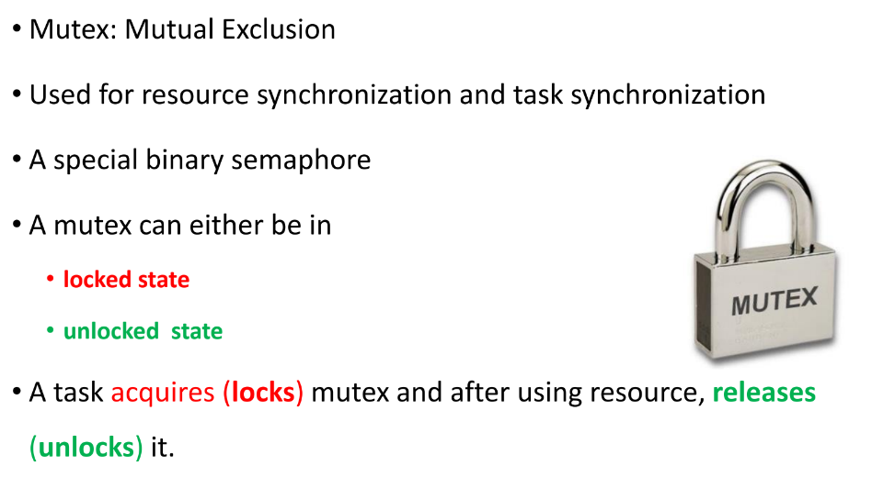
Mutex

Slide 14
Mutex
Mutex is a specific kind of binary semaphore that is used to provide a locking mechanism. It stands for Mutual Exclusion Object. Mutex is mainly used to provide mutual exclusion to a specific portion of the code so that the process can execute and work with a particular section of the code at a particular time.
Mutex uses a priority inheritance mechanism to avoid priority inversion issues. The priority inheritance mechanism keeps higher-priority processes in the blocked state for the minimum possible time. However, this cannot avoid the priority inversion problem, but it can reduce its effect up to an extent.

Slide 15
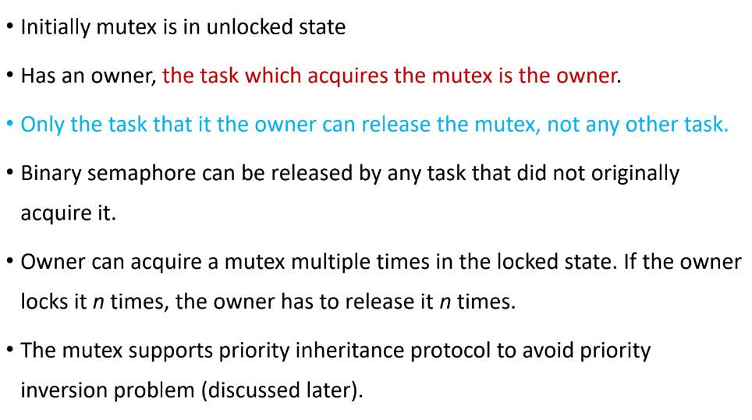
Operations on Mutex

Slide 16
Difference between Mutex and Binary Semaphore
The mutex is a locking mechanism, while the semaphore is a signaling mechanism.
A mutex is an object, Semaphore is an integer variable.
Mutex can be acquired multiple times by the same process but must be released as many times by the same process. Semaphore can not be used like this.
Refer : https://barrgroup.com/blog/mutexes-and-semaphores-demystified for a good explanation.

Slide 17
Typical Code for Mutex
#include<stdio.h>
#include<pthread.h>
#include<semaphore.h>
pthread_mutex_t mutex1;
void *thread_fun1()
{
pthread_mutex_lock(&mutex1);
<<program to get a string from user>>
pthread_mutex_unlock(&mutex1);
sleep(1);
}
void *thread_fun2()
{
pthread_mutex_lock(&mutex1);
<<program to count the number of characters present in user entered string>>
pthread_mutex_unlock(&mutex1);
}
void main()
{
pthread_t mythread1,mythread2;
pthread_mutex_init(&mutex1, NULL);
pthread_create(&mythread1, NULL, thread_fun1, NULL);
pthread_create(&mythread2, NULL, thread_fun2, NULL);
pthread_join(mythread1,NULL);
pthread_join(mythread2,NULL);
pthread_exit(NULL);
}

Slide 18
Pipe
Conceptually, a pipe is a connection between two processes, such that the standard output from one process becomes the standard input of the other process. In UNIX Operating System, Pipes are useful for communication between related processes(inter-process communication).
Pipe is one-way communication only i.e we can use a pipe such that One process write to the pipe, and the other process reads from the pipe. It opens a pipe, which is an area of main memory that is treated as a “virtual file”.
The pipe can be used by the creating process, as well as all its child processes, for reading and writing. One process can write to this “virtual file” or pipe and another related process can read from it.
If a process tries to read before something is written to the pipe, the process is suspended until something is written.
The pipe system call finds the first two available positions in the process’s open file table and allocates them for the read and write ends of the pipe.

Slide 19
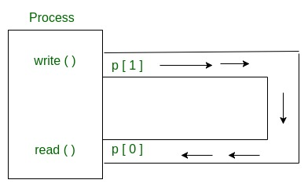
How pipe works

Slide 20
Pipe implementation
Syntax in C language:
int pipe(int fds[2]);
Parameters :
fd[0] will be the fd(file descriptor) for the
read end of pipe.
fd[1] will be the fd for the write end of pipe.
Returns : 0 on Success.
-1 on error.
Pipes behave FIFO(First in First out), Pipe behave like a queue data structure. Size of read and write don’t have to match here. We can write 512 bytes at a time but we can read only 1 byte at a time in a pipe.
Code in the file “pipe.c”

Slide 21
FIFO : Named pipes
A traditional pipe is "unnamed" and lasts only as long as the process. A named pipe, however, can last as long as the system is up, beyond the life of the process.
It can be deleted if no longer used. Usually, a named pipe appears as a file, and generally, processes attach to it for IPC.
An unnamed pipe is only used for communication between a child and its parent process, while a named pipe can be used for communication between two unnamed processes as well. Processes of different ancestry can share data through a named pipe.
A named pipe exists in the file system. After input-output has been performed by the sharing processes, the pipe still exists in the file system independently of the process and can be used for communication between some other processes. On the other hand, an unnamed pipe vanishes as soon as it is closed, or one of the process (parent or child) completes execution.

Slide 22
FIFO : Named pipes
Creating a FIFO file: In order to create a FIFO file, a function calls i.e. mkfifo() is used.
int mkfifo(const char *pathname, mode_t mode);
mkfifo() makes a FIFO special file with name pathname.
Here mode specifies the FIFO’s permissions. It is modified by the process’s
umask in the usual way: the permissions of the created file are (mode &amp;
~umask).
Using FIFO: As named pipe(FIFO) is a kind of file, we can use all the
system calls associated with it i.e. open, read, write, close.
Example Programs to illustrate the named pipe: There are two programs
that use the same FIFO. Program 1 writes first, then reads. The program 2
reads first, then writes. They both keep doing it until terminated.

Slide 23
Named pipes - code
#include <stdio.h>
#include <string.h>
#include <fcntl.h>
#include <sys/stat.h>
#include <sys/types.h>
#include <unistd.h>
int main()
{
int fd;
// FIFO file path
char * myfifo = "/tmp/myfifo";
// Creating the named file(FIFO)
// mkfifo(<pathname>, <permission>)
mkfifo(myfifo, 0666);
char arr1[80], arr2[80];
while (1)
{
// Open FIFO for write only
fd = open(myfifo, O_WRONLY);
// Take an input arr2ing from user.
// 80 is maximum length
fgets(arr2, 80, stdin);
// Write the input arr2ing on FIFO
// and close it
write(fd, arr2, strlen(arr2)+1);
close(fd);
// Open FIFO for Read only
fd = open(myfifo, O_RDONLY);
// Read from FIFO
read(fd, arr1, sizeof(arr1));
// Print the read message
printf("User2: %s\n", arr1);
close(fd);
}
return 0;
}

Slide 24
Named pipes - code
Program 2(Reads First)
// C program to implement one side of FIFO
// This side reads first, then reads
#include <stdio.h>
#include <string.h>
#include <fcntl.h>
#include <sys/stat.h>
#include <sys/types.h>
#include <unistd.h>
int main()
{
int fd1;
// FIFO file path
char * myfifo = "/tmp/myfifo";
// Creating the named file(FIFO)
// mkfifo(<pathname>,<permission>)
mkfifo(myfifo, 0666);
char str1[80], str2[80];
while (1)
{
// First open in read only and read
fd1 = open(myfifo,O_RDONLY);
read(fd1, str1, 80);
// Print the read string and close
printf("User1: %s\n", str1);
close(fd1);
// Now open in write mode and write
// string taken from user.
fd1 = open(myfifo,O_WRONLY);
fgets(str2, 80, stdin);
write(fd1, str2, strlen(str2)+1);
close(fd1);
}
return 0;
}

Slide 25
Using Shared memory in Linux
Normally, the Unix kernel prohibits one process from accessing (reading, writing) memory belonging to another process
Sometimes, however, this restriction is inconvenient
At such times, System V IPC Shared Memory can be created to specifically allow on process to read and/or write to memory created by another process
It allows two unrelated processes to access the same logical memory.
Shared memory is a very efficient way of transferring data between two running processes.

Slide 26
Advantages of Shared Memory
Random Access
you can update a small piece in the middle of a data structure, rather than the entire structure
Efficiency
unlike message queues and pipes, which copy data from the process into memory within the kernel, shared memory is directly accessed
Shared memory resides in the user process memory, and is then shared among other processes

Slide 27
Disadvantages of Shared Memory
No automatic synchronization as in pipes or message queues (you have to provide any synchronization). Synchronize with semaphores or signals.
You must remember that pointers are only valid within a given process. Thus, pointer offsets cannot be assumed to be valid across inter-process boundaries. This complicates the sharing of linked lists or binary trees.

Slide 28
Usage of Shared Memory
Shared memory is a special range of addresses that is created by IPC for one process and appears in the address space of that process.
Other processes can then “attach” the same shared memory segment into their own address space. All processes can access the memory locations just as if the memory had been allocated by malloc .
If one process writes to the shared memory, the changes immediately become visible to any other process that has access to the same shared memory.

Slide 29
Functions for using Shared Memory (old style)
The functions for shared memory
#include <sys/shm.h>
Get a shared memory block -
int shmget(key_t key, size_t size, int shmflg);
Attach to a shared memory block -
void *shmat(int shm_id, const void *shm_addr, int shmflg);
Shared memory control -
int shmctl(int shm_id, int cmd, struct shmid_ds *buf);
Shared memory detach -
int shmdt(const void *shm_addr);
As with semaphores, the include files sys/types.h and sys/ipc.h are normally automatically included by shm.h .

Slide 30
Creating Shared Memory (Old Style)
int shmget(key_t key, size_t size, int shmflg);
key is either a number or the constant IPC_PRIVATE (man ftok)
a shmid is returned
key_t ftok(const char * path, int id) will return a key value for IPC usage
size is the size of the shared memory data
shmflg is a rights mask (0666) OR’d with one of the following:
IPC_CREAT will create or attach
IPC_EXCL creates new or it will error if it exists

Slide 31
Attaching to Shared Memory
After obtaining a shmid from shmget(), you need to attach or map the shared memory segment to your data reference:
void * shmat(int shmid, void * shmaddr, int shmflg)
shmid is the id returned from shmget()
shmaddr is the shared memory segment address. Set this to NULL and let the system handle it.
shmflg is one of the following (usually 0):
SHM_RDONLY sets the segment readonly
SHM_RND sets page boundary access
SHM_SHARE_MMU set first available aligned address

Slide 32
Shared Memory Control
struct shmid_ds {
int shm_segsz; /* size of segment in bytes */
__time_t shm_atime; /* time of last shmat command */
__time_t shm_dtime; /* time of last shmdt command */
...
unsigned short int __shm_npages; /* size of segment in pages */
msgqnum_t shm_nattach; /* number of current attaches */
... /* pids of creator and last shmop */
};
int shmctl(int shmid, int cmd, struct shmid_ds * buf);
cmd can be one of:
IPC_RMID destroy the memory specified by shmid
IPC_SET set the uid, gid, and mode of the shared mem
IPC_STAT get the current shmid_ds struct for the queue
Example code →

Slide 33
Sample code
SHARED MEMORY FOR READER PROCESS
SHARED MEMORY FOR WRITER PROCESS
#include <iostream> #include <sys/ipc.h> #include <sys/shm.h> #include <stdio.h> using namespace std; int main() { // ftok to generate unique key key_t key = ftok("shmfile",65); // shmget returns an identifier in shmid int shmid = shmget(key,1024,0666|IPC_CREAT); // shmat to attach to shared memory char *str = (char*) shmat(shmid,(void*)0,0); printf("Data read from memory: %s\n",str); //detach from shared memory shmdt(str); // destroy the shared memory shmctl(shmid,IPC_RMID,NULL); return 0; }
#include <iostream> #include <sys/ipc.h> #include <sys/shm.h> #include <stdio.h> using namespace std; int main() { // ftok to generate unique key key_t key = ftok("shmfile",65); // shmget returns an identifier in shmid int shmid = shmget(key,1024,0666|IPC_CREAT); // shmat to attach to shared memory char *str = (char*) shmat(shmid,(void*)0,0); cout<<"Write Data : "; gets(str); printf("Data written in memory: %s\n",str); //detach from shared memory shmdt(str); return 0; }

Slide 34
Calls explanation
ftok(): converts a pathname and a project identifier to a unique System V IPC key
shmget(): upon successful completion, shmget() returns an identifier for the shared memory segment.
shmat(): Before you can use a shared memory segment, you have to attach yourself to it using shmat().
void *shmat(int shmid ,void *shmaddr ,int shmflg); shmid is shared memory id. shmaddr specifies specific address to use but we should set it to zero and OS will automatically choose the address.
shmdt(): When you’re done with the shared memory segment, your program should detach itself from it using shmdt().
shmctl(): when you detach from shared memory,it is not destroyed. To destroy it, shmctl() is used.

Slide 35
Shared Memory using mmap() system call
#include <string.h>
#include <unistd.h>
int main() {
char parent_message[] = "hello"; // parent process will write this message
char child_message[] = "goodbye"; // child process will then write this one
void* shmem = create_shared_memory(128);
memcpy(shmem, parent_message, sizeof(parent_message));
int pid = fork();
if (pid == 0) {
printf("Child read: %s\n", shmem);
memcpy(shmem, child_message, sizeof(child_message));
printf("Child wrote: %s\n", shmem);
} else {
printf("Parent read: %s\n", shmem);
sleep(1);
printf("After 1s, parent read: %s\n", shmem);
}
}
#include <stdio.h>
#include <stdlib.h>
#include <sys/mman.h>
void* create_shared_memory(size_t size) {
// Our memory buffer will be readable and writable:
int protection = PROT_READ | PROT_WRITE;
// The buffer will be shared (meaning other processes can access it), but anonymous (meaning third-party processes cannot obtain an address for it), so only this process and its children will be able to use it:
int visibility = MAP_SHARED | MAP_ANONYMOUS;
// The remaining parameters to `mmap()` are not important for this use case,
// but the manpage for `mmap` explains their purpose.
return mmap(NULL, size, protection, visibility, -1, 0);
}

Slide 36
Message Queue
A linked list of messages stored within the kernel and identified by a message queue identifier.
A new queue is created or an existing queue opened by msgget().
New messages are added to the end of a queue by msgsnd().
Every message has a positive long integer type field, a non-negative length, and the actual data bytes (corresponding to the length), all of which are specified to msgsnd() when the message is added to a queue.
Messages are fetched from a queue by msgrcv(). We don’t have to fetch the messages in a first-in, first-out order. Instead, we can fetch messages based on their type field.
All processes can exchange information through access to a common system message queue. The sending process places a message (via some (OS) message-passing module) onto a queue which can be read by another process.
Each message is given an identification or type so that processes can select the appropriate message. Process must share a common key in order to gain access to the queue in the first place.

Slide 37
System calls used for message queues:
ftok(): is use to generate a unique key.
msgget(): either returns the message queue identifier for a newly created message queue or returns the identifiers for a queue which exists with the same key value.
msgsnd(): Data is placed on to a message queue by calling msgsnd().
msgrcv(): messages are retrieved from a queue.
msgctl(): It performs various operations on a queue. Generally it is use to destroy message queue.

Slide 38
Code for message queue (Writer)
#include <stdio.h>
#include <sys/ipc.h>
#include <sys/msg.h>
#define MAX 10
// structure for message queue
struct mesg_buffer {
long mesg_type;
char mesg_text[100];
} message;
int main()
{
key_t key;
int msgid;
// ftok to generate unique key
key = ftok("progfile", 65);
// msgget creates a message queue
// and returns identifier
msgid = msgget(key, 0666 | IPC_CREAT);
message.mesg_type = 1;
printf("Write Data : ");
fgets(message.mesg_text,MAX,stdin);
// msgsnd to send message
msgsnd(msgid, &message, sizeof(message), 0);
// display the message
printf("Data send is : %s \n", message.mesg_text);
return 0;
}

Slide 39
Code for message queue (Writer)
#include <stdio.h>
#include <sys/ipc.h>
#include <sys/msg.h>
#define MAX 10
// structure for message queue
struct mesg_buffer {
long mesg_type;
char mesg_text[100];
} message;
int main()
{
key_t key;
int msgid;
// ftok to generate unique key
key = ftok("progfile", 65);
// msgget creates a message queue
// and returns identifier
msgid = msgget(key, 0666 | IPC_CREAT);
message.mesg_type = 1;
printf("Write Data : ");
fgets(message.mesg_text,MAX,stdin);
// msgsnd to send message
msgsnd(msgid, &message, sizeof(message), 0);
// display the message
printf("Data send is : %s \n", message.mesg_text);
return 0;
}

Slide 40
Code for message queue (Reader)
// C Program for Message Queue (Reader Process)
#include <stdio.h>
#include <sys/ipc.h>
#include <sys/msg.h>
// structure for message queue
struct mesg_buffer {
long mesg_type;
char mesg_text[100];
} message;
int main()
{
key_t key;
int msgid;
// ftok to generate unique key
key = ftok("progfile", 65);
// msgget creates a message queue
// and returns identifier
msgid = msgget(key, 0666 | IPC_CREAT);
// msgrcv to receive message
msgrcv(msgid, &message, sizeof(message), 1, 0);
// display the message
printf("Data Received is : %s \n",
message.mesg_text);
// to destroy the message queue
msgctl(msgid, IPC_RMID, NULL);
return 0;
}

Slide 41
Signals as IPC
A signal interrupts an executing program and, in this sense, communicates with it.
Most signals can be either ignored (blocked) or handled (through designated code), with SIGSTOP (pause) and SIGKILL (terminate immediately) as the two notable exceptions.
Symbolic constants such as SIGKILL have integer values, in this case, 9.
Signals can arise in user interaction. For example, a user hits Ctrl+C from the command line to terminate a program started from the command-line; Ctrl+C generates a SIGTERM signal. SIGTERM for terminate, unlike SIGKILL, can be either blocked or handled.
One process also can signal another, thereby making signals an IPC mechanism.

Slide 42
Code example for Signals as IPC
#include <stdio.h>
#include <signal.h>
#include <stdlib.h>
#include <unistd.h>
#include <sys/wait.h>
void graceful(int signum) {
printf("\tChild confirming received signal: %i\n", signum);
puts("\tChild about to terminate gracefully...");
sleep(1);
puts("\tChild terminating now...");
_exit(0); /* fast-track notification of parent */
}
void set_handler() {
struct sigaction current;
sigemptyset(&current.sa_mask); /* clear the signal set */
current.sa_flags = 0; /* enables setting sa_handler, not sa_action */
current.sa_handler = graceful; /* specify a handler */
sigaction(SIGTERM, &current, NULL); /* register the handler */
}
if (0 == pid) child_code(); else parent_code(pid); return 0; /* normal */ }
void child_code() {
set_handler();
while (1) { /** loop until interrupted **/
sleep(1);
puts("\tChild just woke up, but going back to sleep.");
}
}
void parent_code(pid_t cpid) {
puts("Parent sleeping for a time...");
sleep(5);
/* Try to terminate child. */
if (-1 == kill(cpid, SIGTERM)) {
perror("kill");
exit(-1);
}
wait(NULL); /** wait for child to terminate **/
puts("My child terminated, about to exit myself...");
}
int main() {
pid_t pid = fork();
if (pid < 0) {
perror("fork");
return -1; /* error */
}
if (0 == pid)
child_code();
else
parent_code(pid);
return 0; /* normal */
}

Slide 43
Code example for Signals as IPC
The shutdown program above simulates the graceful shutdown of a multi-processing system, in this case, a simple one consisting of a parent process and a single child process. The simulation works as follows:
The parent process tries to fork a child. If the fork succeeds, each process executes its own code: the child executes the function child_code, and the parent executes the function parent_code.
The child process goes into a potentially infinite loop in which the child sleeps for a second, prints a message, goes back to sleep, and so on. It is precisely a SIGTERM signal from the parent that causes the child to execute the signal-handling callback function graceful. The signal thus breaks the child process out of its loop and sets up the graceful termination of both the child and the parent. The child prints a message before terminating.
The parent process, after forking the child, sleeps for five seconds so that the child can execute for a while; of course, the child mostly sleeps in this simulation. The parent then calls the kill function with SIGTERM as the second argument, waits for the child to terminate, and then exits.

